Slide 1
Backpropagation

Slide 2
Gradient Descent
Network parameters
Starting Parameters
……
Millions of parameters ……
To compute the gradients efficiently, we use backpropagation.
Notes:
A network can have millions of parameters.
Backpropagation is the way to compute the gradients efficiently (not today)
Ref: http://speech.ee.ntu.edu.tw/~tlkagk/courses/MLDS_2015_2/Lecture/DNN%20backprop.ecm.mp4/index.html
What is the suitable value for η?
I don’t know. Depend on C(θ)

Slide 3
Chain Rule
Case 1
Case 2

Slide 4

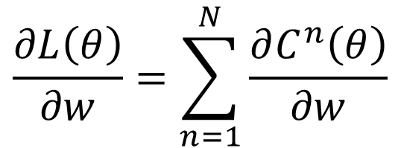

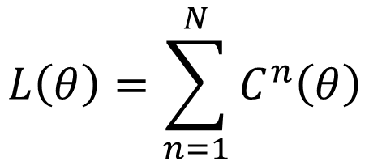





Backpropagation
x^{n}
NN
$$θ$$
y^{n}
$${\hat{y}}^{n}$$
$$C^{n}$$
$$L\left(θ\right)=\sum_{n=1}^{N}{C^{n}\left(θ\right)}$$
$$\frac{∂L\left(θ\right)}{∂w}=\sum_{n=1}^{N}{\frac{∂C^{n}\left(θ\right)}{∂w}}$$
$$y_{1}$$
$$x_{1}$$
$$x_{2}$$
$$y_{2}$$

Slide 5
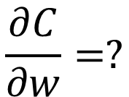


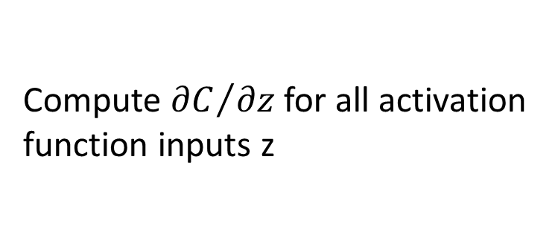



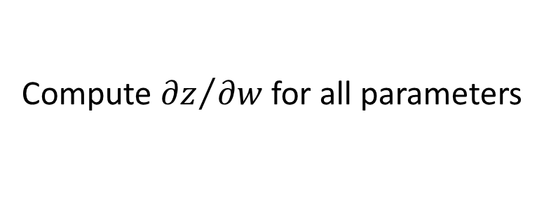


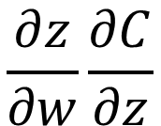

Backpropagation
$$w_{1}$$
$$z$$
$$x_{1}$$
……
$$y_{1}$$
$$w_{2}$$
b
……
$$z=x_{1}w_{1}+x_{2}w_{2}+b$$
$$x_{2}$$
$$y_{2}$$
Forward pass:
$$\frac{∂C}{∂w}=?$$
$$\frac{∂z}{∂w}\frac{∂C}{∂z}$$
Compute ${∂z}/{∂w}$ for all parameters
Backward pass:
(Chain rule)
Compute ${∂C}/{∂z}$ for all activation function inputs z
Notes:
後面的值很大

Slide 6













Backpropagation – Forward pass
Compute ${∂z}/{∂w}$ for all parameters
$$w_{1}$$
$$z$$
$$x_{1}$$
……
$$y_{1}$$
$$w_{2}$$
b
……
$$z=x_{1}w_{1}+x_{2}w_{2}+b$$
$$x_{2}$$
$$y_{2}$$
$${∂z}/{∂w_{1}}=?$$
$$x_{1}$$
The value of the input connected by the weight
$${∂z}/{∂w_{2}}=?$$
$$x_{2}$$

Slide 7
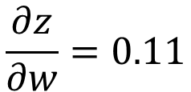
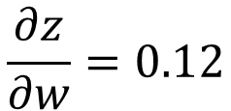
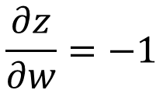
Backpropagation – Forward pass
Compute ${∂z}/{∂w}$ for all parameters
1
0.98
2
0.86
3
1
-2
-1
-1
1
0
-2
-1
0.12
-2
0.11
-1
-1
1
-1
4
0
0
2
$$\frac{∂z}{∂w}=−1$$
$$\frac{∂z}{∂w}=0.12$$
$$\frac{∂z}{∂w}=0.11$$
Notes:
That’s it. We have done the forward pass.

Slide 8











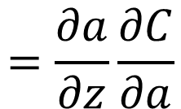


Backpropagation – Backward pass
Compute ${∂C}/{∂z}$ for all activation function inputs z
$$w_{1}$$
$$z$$
$$a$$
$$w_{3}$$
$$z′$$
$$x_{1}$$
$$a=σ\left(z\right)$$
$$w_{2}$$
b
$$w_{4}$$
$z$’’
$$x_{2}$$
$$\frac{∂C}{∂z}$$
$$=\frac{∂a}{∂z}\frac{∂C}{∂a}$$
$$σ′\left(z\right)$$

Slide 9
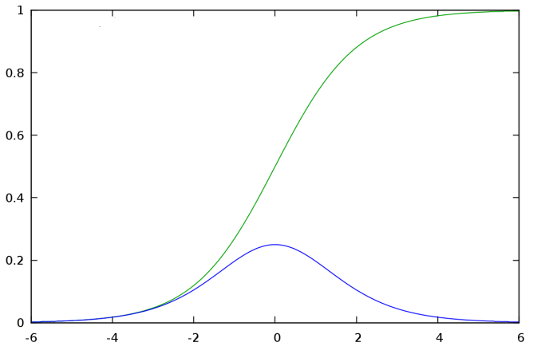


Backpropagation – Backward pass
Compute ${∂C}/{∂z}$ for all activation function inputs z
$$w_{1}$$
$$z$$
$$a$$
$$w_{3}$$
$$z′$$
$$x_{1}$$
$$a=σ\left(z\right)$$
$$w_{2}$$
b
$$w_{4}$$
$z$’’
$$x_{2}$$
$$σ\left(z\right)$$
$$\frac{∂C}{∂z}$$
$$=\frac{∂a}{∂z}\frac{∂C}{∂a}$$
$$σ′\left(z\right)$$
$$σ′\left(z\right)$$

Slide 10



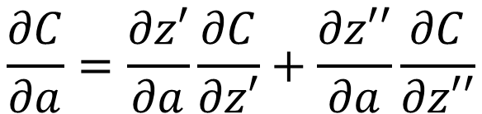
Backpropagation – Backward pass
Compute ${∂C}/{∂z}$ for all activation function inputs z
$$w_{1}$$
$$z$$
$$a$$
$$w_{3}$$
$$z′$$
$$x_{1}$$
$$a=σ\left(z\right)$$
$$z′=aw_{3}+⋯$$
$$w_{2}$$
b
$$w_{4}$$
$z$’’
$$x_{2}$$
$$\frac{∂C}{∂z}$$
$$=\frac{∂a}{∂z}\frac{∂C}{∂a}$$
$$\frac{∂C}{∂a}=\frac{∂z′}{∂a}\frac{∂C}{∂z′}+\frac{∂z′′}{∂a}\frac{∂C}{∂z′′}$$
(Chain rule)
?
?
Assumed it’s known
$$w_{3}$$
$$w_{4}$$
Notes:
How to explain this chain rule

Slide 11

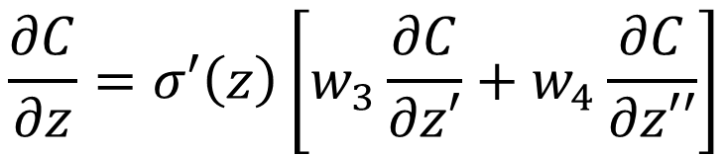

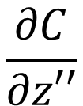
Backpropagation – Backward pass
Compute ${∂C}/{∂z}$ for all activation function inputs z
$$w_{1}$$
$$z$$
$$a$$
$$w_{3}$$
$$z′$$
$$x_{1}$$
$$\frac{∂C}{∂z}$$
$$\frac{∂C}{∂z′}$$
$$w_{2}$$
b
$$w_{4}$$
$z$’’
$$x_{2}$$
$$\frac{∂C}{∂z′′}$$
$$\frac{∂C}{∂z}=σ′\left(z\right)\left[w_{3}\frac{∂C}{∂z′}+w_{4}\frac{∂C}{∂z′′}\right]$$
Notes:
How to explain this chain rule

Slide 12

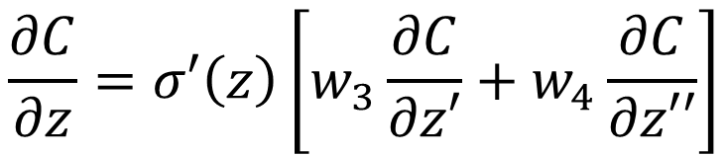
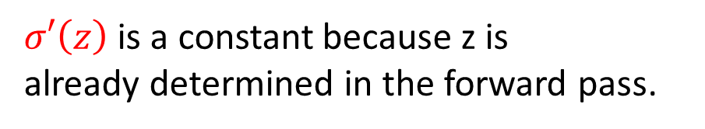
Backpropagation – Backward pass
$$σ′\left(z\right)$$
$$w_{3}$$
$$\frac{∂C}{∂z}$$
$$\frac{∂C}{∂z′}$$
$$w_{4}$$
$σ′\left(z\right)$ is a constant because z is
already determined in the forward pass.
$$\frac{∂C}{∂z′′}$$
$$\frac{∂C}{∂z}=σ′\left(z\right)\left[w_{3}\frac{∂C}{∂z′}+w_{4}\frac{∂C}{∂z′′}\right]$$
Notes:
How to explain this chain rule

Slide 13
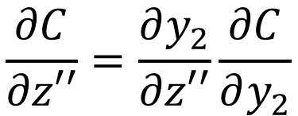
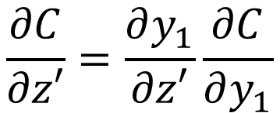


Backpropagation – Backward pass
Compute ${∂C}/{∂z}$ for all activation function inputs z
$$w_{1}$$
$$z$$
$$a$$
$$w_{3}$$
$$z′$$
$$x_{1}$$
$$y_{1}$$
$$\frac{∂C}{∂z}$$
$$\frac{∂C}{∂z′}$$
$$w_{2}$$
b
$$w_{4}$$
$z$’’
$$y_{2}$$
$$x_{2}$$
$$\frac{∂C}{∂z′′}$$
Case 1. Output Layer
$$\frac{∂C}{∂z′}=\frac{∂y_{1}}{∂z′}\frac{∂C}{∂y_{1}}$$
$$\frac{∂C}{∂z′′}=\frac{∂y_{2}}{∂z′′}\frac{∂C}{∂y_{2}}$$
Done!
Notes:
How to explain this chain rule

Slide 14


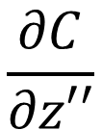

Backpropagation – Backward pass
Compute ${∂C}/{∂z}$ for all activation function inputs z
Case 2. Not Output Layer
$$z′$$
……
$$\frac{∂C}{∂z′}$$
$z$’’
……
$$\frac{∂C}{∂z′′}$$
Notes:
How to explain this chain rule

Slide 15

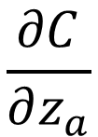

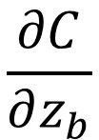



Backpropagation – Backward pass
Compute ${∂C}/{∂z}$ for all activation function inputs z
Case 2. Not Output Layer
$$z′$$
$$a′$$
$$w_{5}$$
$$z_{a}$$
$$\frac{∂C}{∂z′}$$
$$\frac{∂C}{∂z_{a}}$$
$$w_{6}$$
$z$’’
$$z_{b}$$
$$\frac{∂C}{∂z′′}$$
$$\frac{∂C}{∂z_{b}}$$
Notes:
How to explain this chain rule

Slide 16

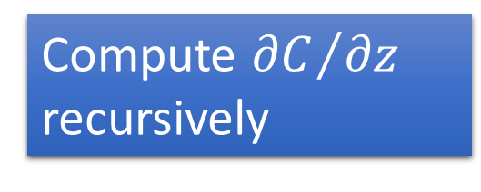
Backpropagation – Backward pass
Compute ${∂C}/{∂z}$ for all activation function inputs z
Case 2. Not Output Layer
Compute ${∂C}/{∂z}$ recursively
$$z′$$
$$a′$$
$$w_{5}$$
$$z_{a}$$
$$\frac{∂C}{∂z′}$$
$$\frac{∂C}{∂z_{a}}$$
$$σ′\left(z′\right)$$
Until we reach the output layer ……
$$w_{6}$$
$z$’’
$$z_{b}$$
$$\frac{∂C}{∂z′′}$$
$$\frac{∂C}{∂z_{b}}$$
Notes:
How to explain this chain rule

Slide 17

















Backpropagation – Backward Pass
Compute ${∂C}/{∂z}$ for all activation function inputs z
Compute ${∂C}/{∂z}$ from the output layer
$$\frac{∂C}{∂z_{1}}$$
$$\frac{∂C}{∂z_{3}}$$
$$\frac{∂C}{∂z_{5}}$$
$$z_{1}$$
$$z_{3}$$
$$z_{5}$$
$$y_{1}$$
$$x_{1}$$
$$x_{2}$$
$$y_{2}$$
$$z_{2}$$
$$z_{4}$$
$$z_{6}$$
$$\frac{∂C}{∂z_{2}}$$
$$\frac{∂C}{∂z_{4}}$$
$$\frac{∂C}{∂z_{6}}$$

Slide 18







Backpropagation – Backward Pass
Compute ${∂C}/{∂z}$ for all activation function inputs z
Compute ${∂C}/{∂z}$ from the output layer
$$\frac{∂C}{∂z_{1}}$$
$$\frac{∂C}{∂z_{3}}$$
$$\frac{∂C}{∂z_{5}}$$
$$z_{1}$$
$$z_{3}$$
$$z_{5}$$
$$y_{1}$$
$$x_{1}$$
$$σ′\left(z_{1}\right)$$
$$σ′\left(z_{3}\right)$$
$$σ′\left(z_{2}\right)$$
$$σ′\left(z_{4}\right)$$
$$x_{2}$$
$$y_{2}$$
$$z_{2}$$
$$z_{4}$$
$$z_{6}$$
$$\frac{∂C}{∂z_{2}}$$
$$\frac{∂C}{∂z_{4}}$$
$$\frac{∂C}{∂z_{6}}$$

Slide 19



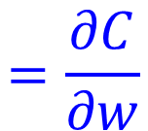

Backpropagation – Summary
Forward Pass
Backward Pass
…
…
…
…
$$a$$
$$\frac{∂z}{∂w}$$
X
$$\frac{∂C}{∂z}$$
$$=\frac{∂C}{∂w}$$
$$=a$$
for all w

